Slide 1

IKEA Hacks: Information Retrieval
Project Pipeline & Features Overview

Slide 2
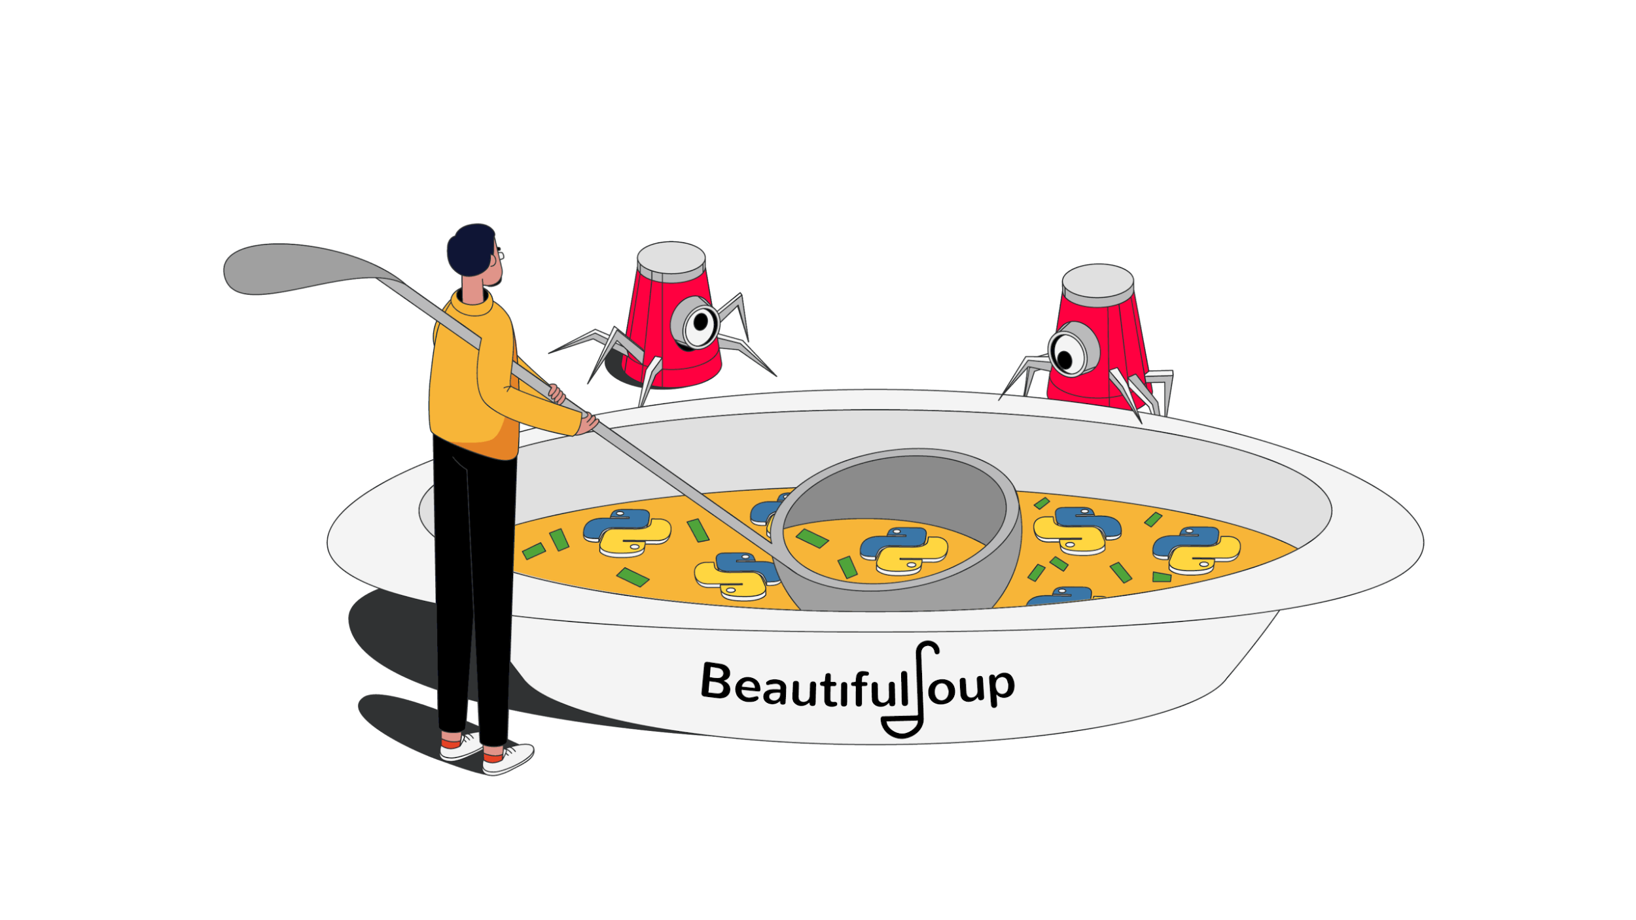






Architecture & Tech Stack
01. Scraping
02. Database
04. API Framework
05. Frontend
06. Styling
03. Indexing

Slide 3




Scraping Pipeline
Tools: Beautiful Soup, Selenium
Websites: IKEAHackers, TheSpruce, Trustpilot

Slide 4
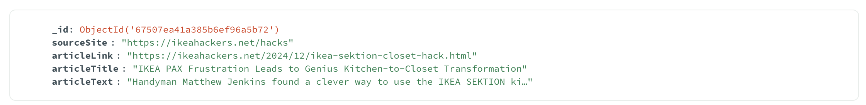
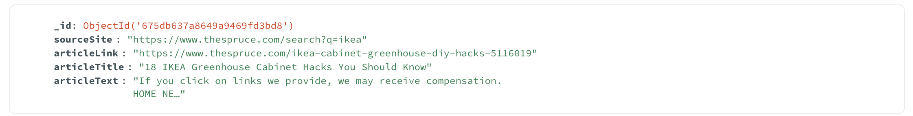
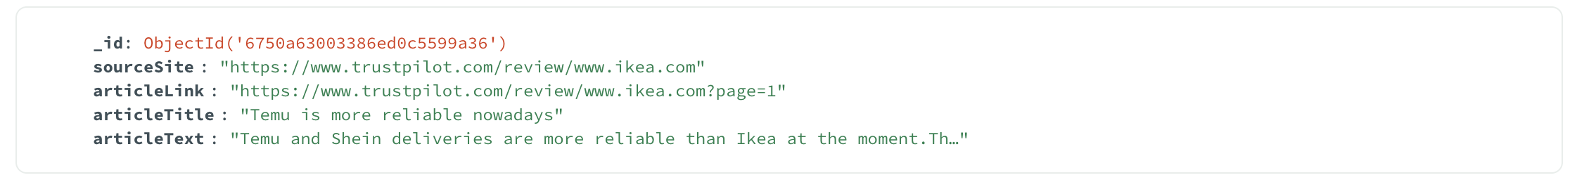
Data Storage - MongoDB
Scraped Fields: Title, Text, Source Link
Preprocessed and Indexed with PyTerrier
Ikea Hackers Article
Spruce Article
Trustpilot Review

Slide 5
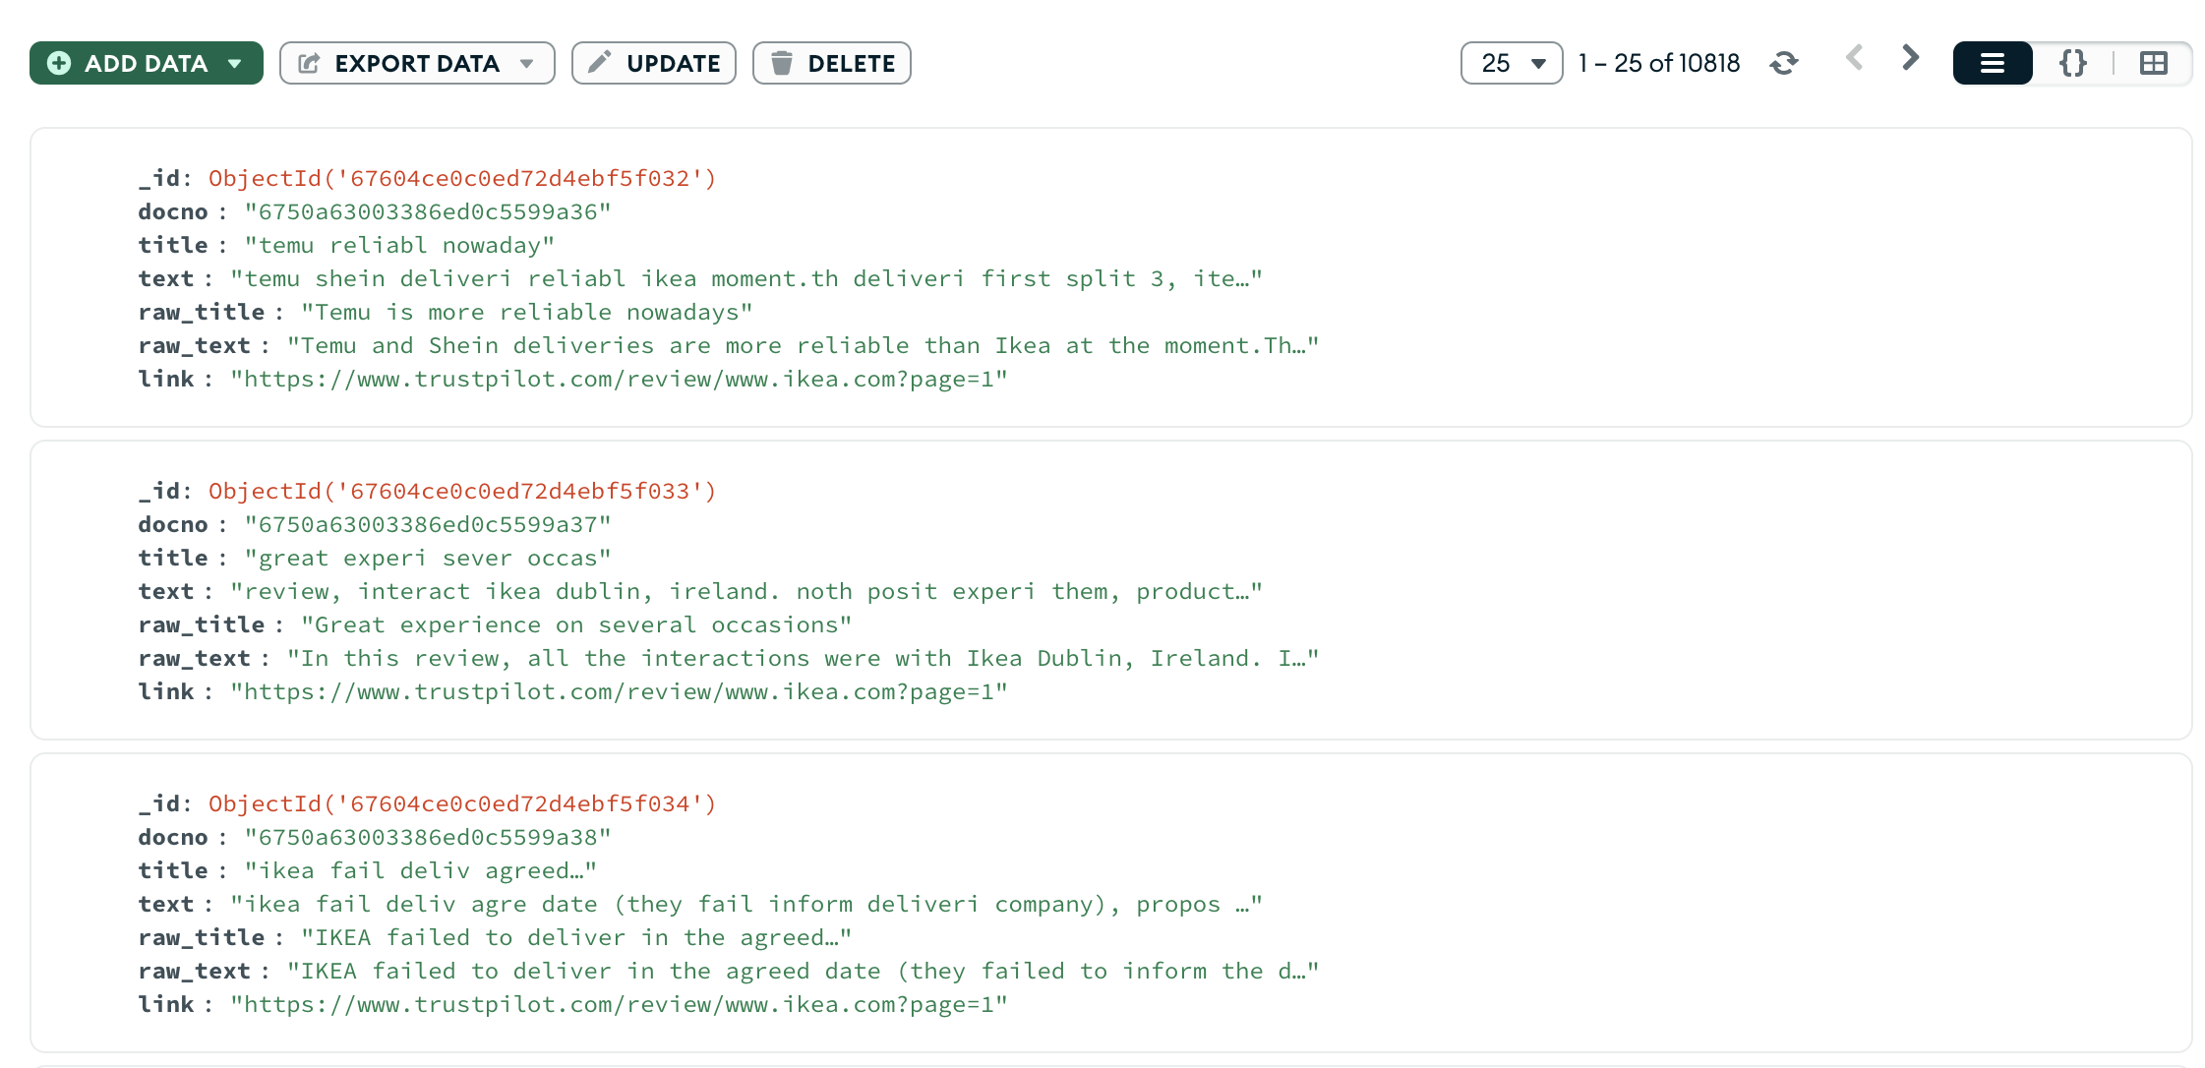
Preprocessing and Indexing
Steps: Tokenization, Stop word Removal, Stemming
Stored Preprocessed Data back in MongoDB
Stored Fields for Further Indexing:
Original Title & Text for Frontend
Processed Title & Text
Source Link

Slide 6


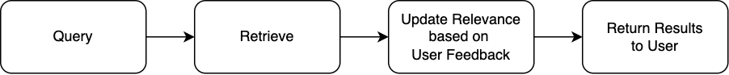
Backend Pipeline: Django
Logic: 1. Query → User submits a search query through the frontend. 2. Retrieve → Django fetches relevant documents from the indexed directory named ikea_index. 3. Update Relevance → Adjust scores dynamically based on user feedback. 4. Return Results → Send updated results back to the frontend.
Dynamic Score Adjustments: Feedback increases or decreases relevance scores:
+50% or -50%, reranking the results.

Slide 7
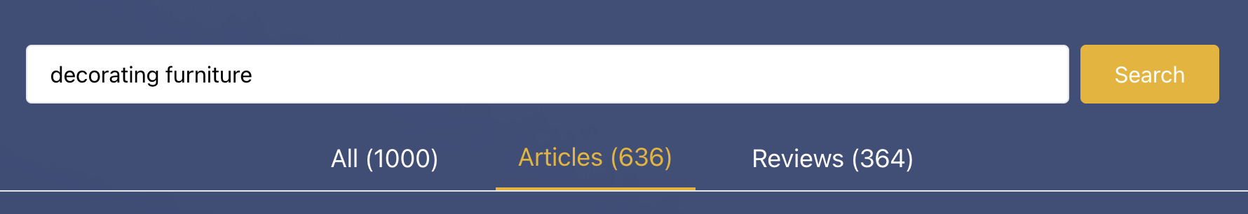
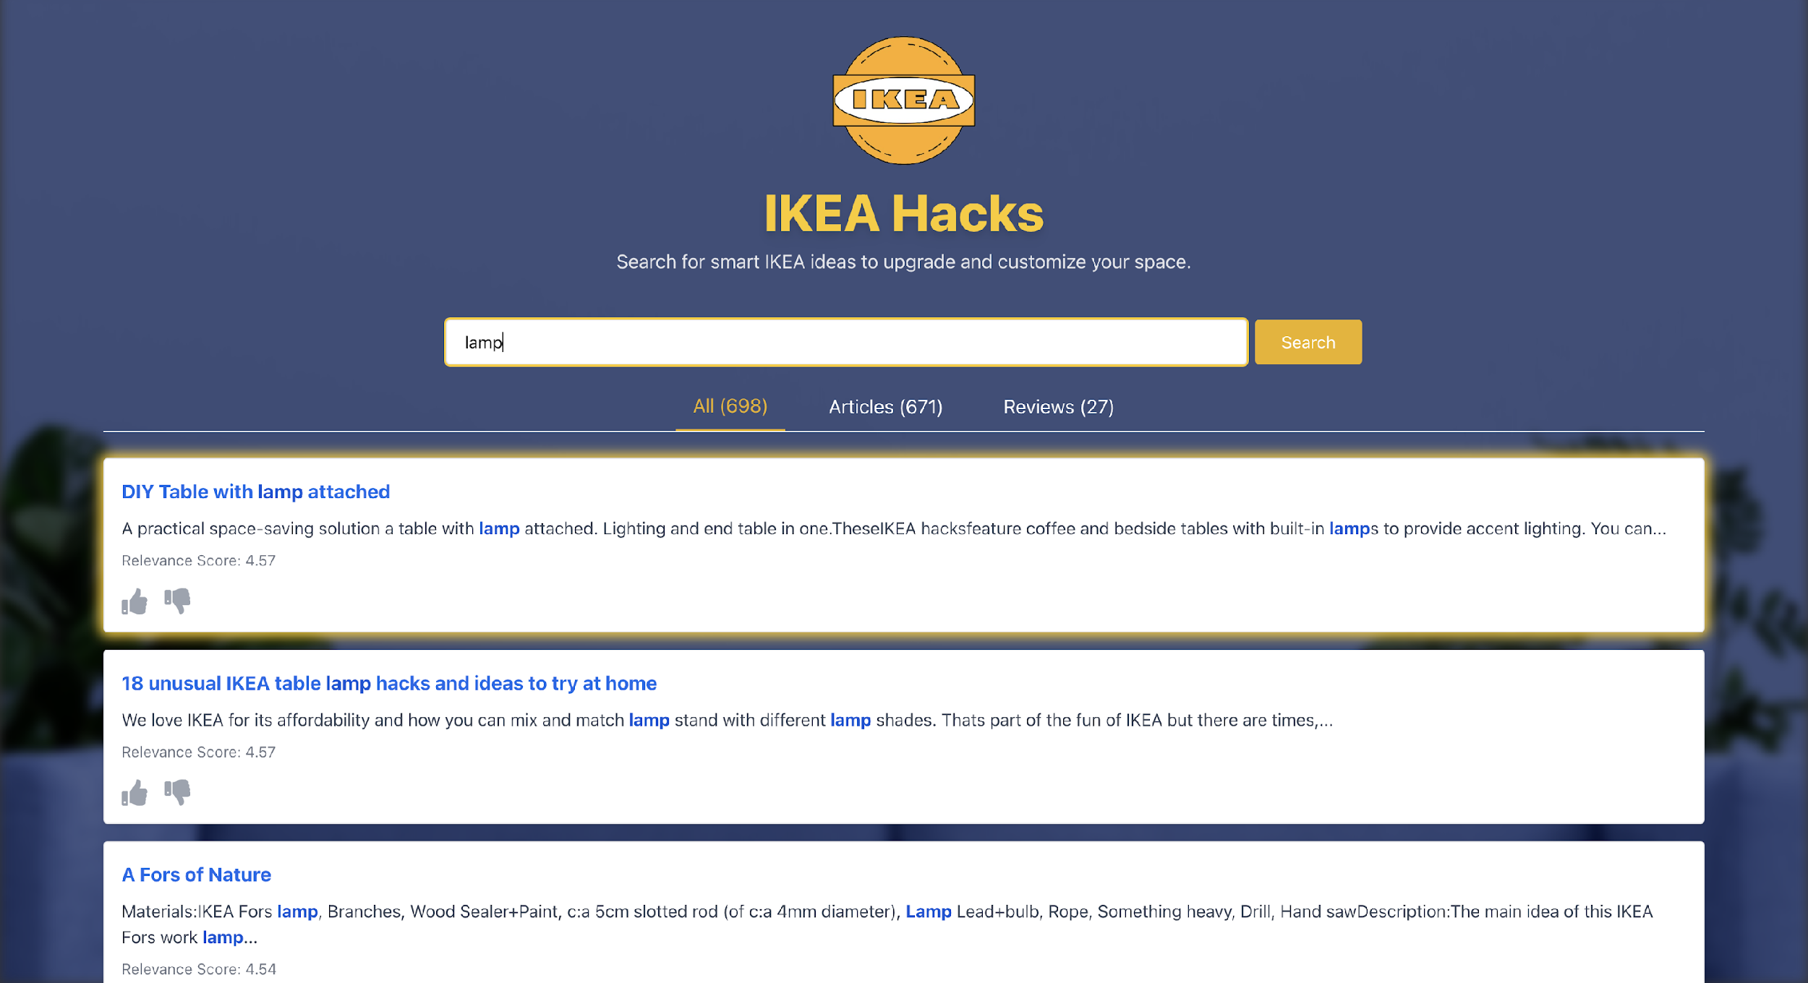
Frontend Features - React & Tailwind
Basic: Google Style Results Snippets Complex: User Feedback
Dynamic Results Clustering: (All-Articles-Reviews Sections) Pagination

Slide 8
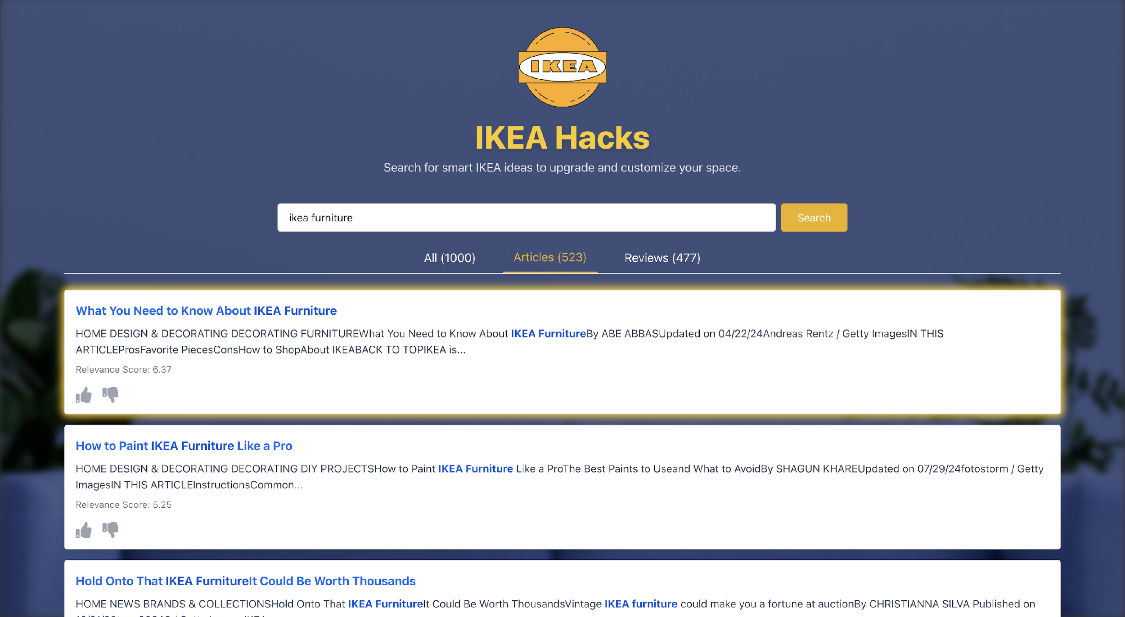
Articles Section: Results Snippets

Slide 9
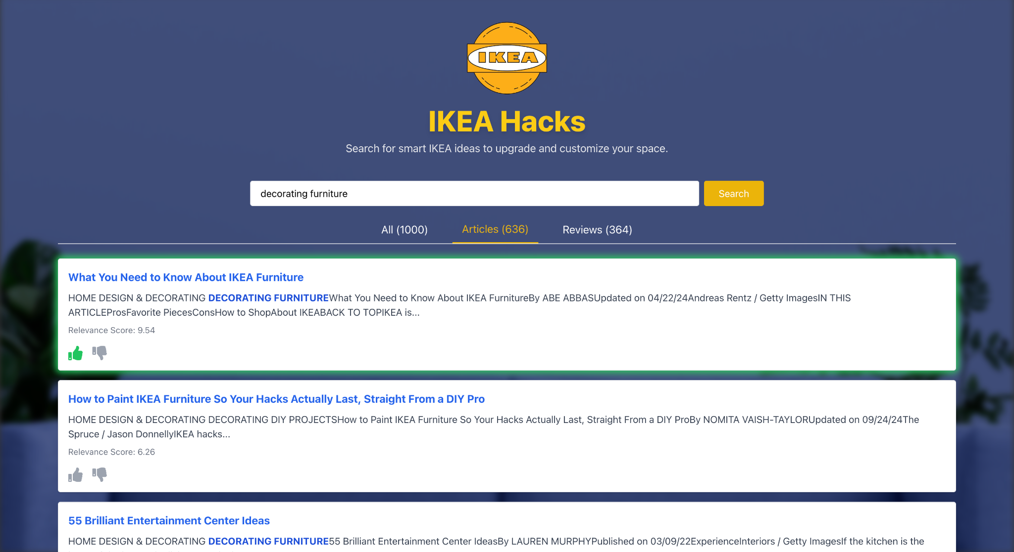
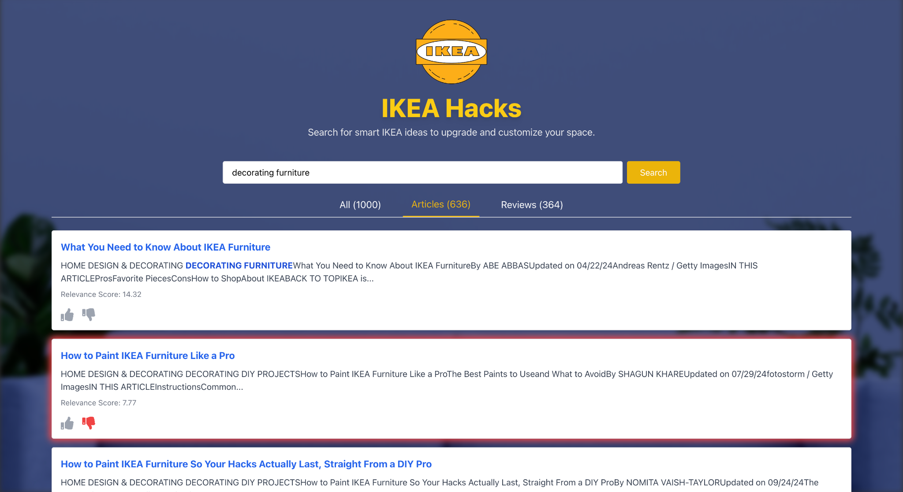
Feedback Mechanism
Positive Feedback: Green Highlight
Frontend collects and sends feedback
to backend, which then either rewards
or penalizes relevance score (+50% / -50%)
Negative Feedback: Red Highlight
Upon backend operations,
Frontend dynamically updates interface
(Relevance Scores, Results Reorder)
Based on results received from backend

Slide 10
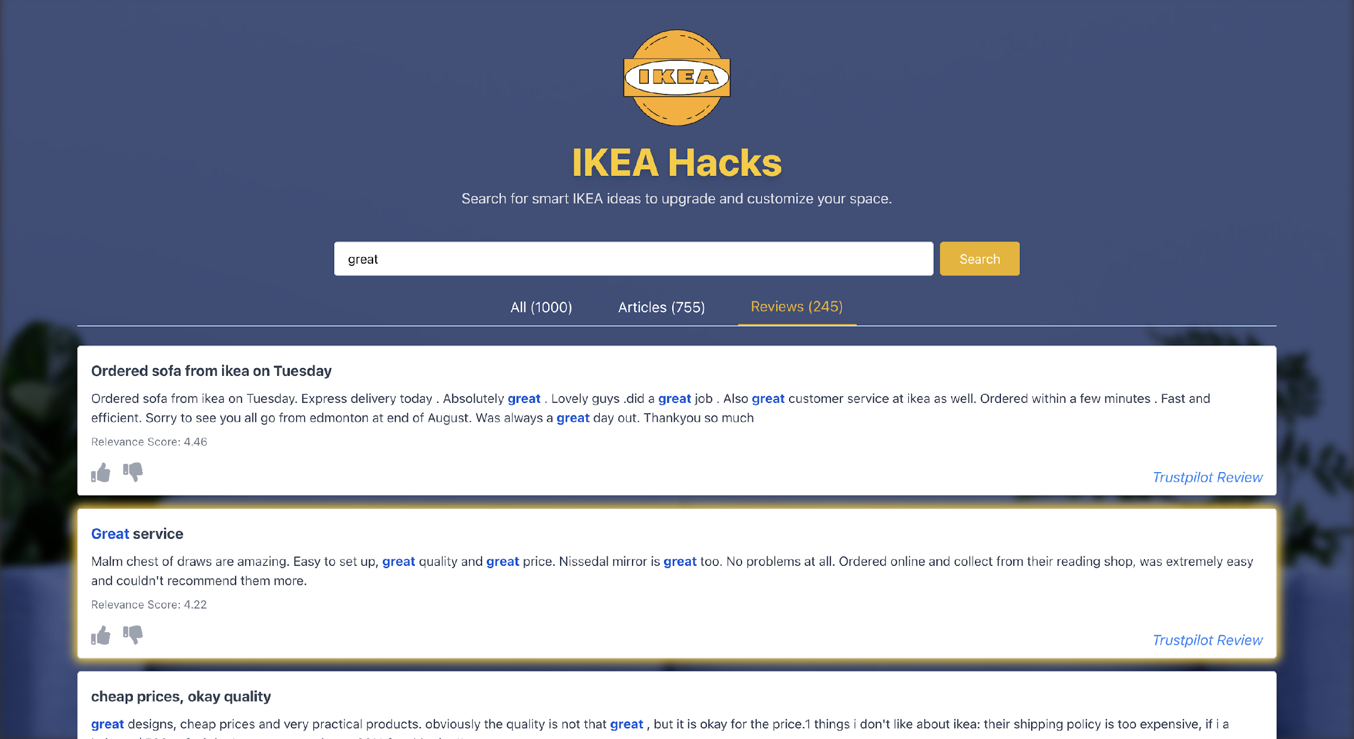
Reviews Section
Notice that reviews section comes after articles section
because there are less reviews than articles in the current search request

Slide 11
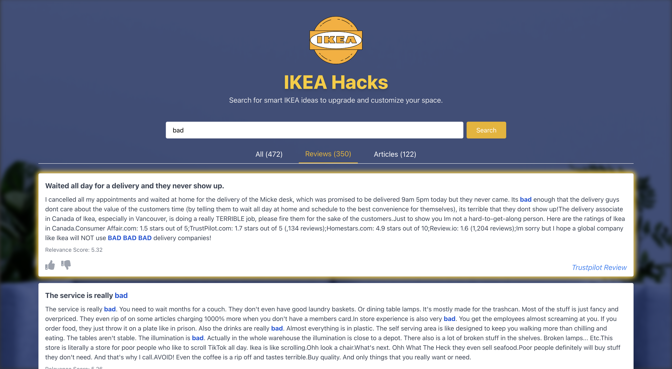
Sections are sorted by the number of results they have based on the given query

